Slide 1

jSymbolic and ELVIS
Cory McKay
Marianopolis College
Montreal, Canada

Slide 2
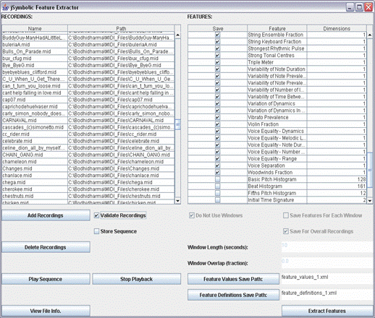
What is jSymbolic?
Software that extracts statistical descriptors (called “features”) from symbolic music files
Can read:
MIDI
MEI (soon)
Saves extracted features as:
ACE XML
Weka ARFF (soon)
Something else?
Can be used in three ways:
GUI (right)
Command line (for batch processing)
Java API (for using jSybolic via other software)

Slide 3
Which features? (1/2)
111 features are currently implemented
49 more have been designed and are to be implemented soon
We also want to add new ones that you might find useful
Histogram aggregators are used
e.g. beat histograms, pitch class histograms, etc.
Features fall into 7 broad categories . . .

Slide 4
Which features? (2/2)
Pitch Statistics:
What are the occurrence rates of different notes, in terms of both pitches and pitch classes? How tonal is the piece? What is its range? How much variety in pitch is there?
Melody:
What kinds of melodic intervals are present? How much melodic variation is there? What kinds of melodic contours are used? What types of phrases are used and how often are they repeated?
Texture:
How many independent voices are there and how do they interact (e.g., polyphonic, homophonic, etc.)? What is the relative importance of different voices?
Chords (coming sooon):
What vertical intervals are present? What types of chords do they represent? How much harmonic movement is there and how fast is it?
Rhythm:
The time intervals between the attacks of different notes and the durations of each note are considered. What metrical structures and rhythmic patterns are present? Is rubato used? How does rhythm vary from voice to voice?
Instrumentation:
What types of instruments are present and which are given particular importance relative to others? The importance of both pitched and non-pitched instruments is considered.
Dynamics:
How loud are notes and what kinds of variations in dynamics occur?

Slide 5
Demo
Using the GUI
Josquin des Prez: Et incarnatus est
Looking at the results
Very ugly for people to look at
Breathtakingly beautiful for a computer

Slide 6
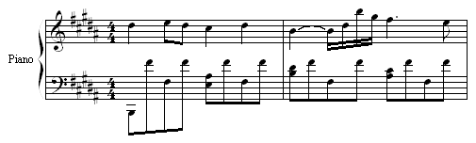
Chopin’s Nocturne in B, Op. 32, No. 1
Average Note To Note Dynamics Change: 6.03
Chromatic Motion: 0.0769
Dominant Spread: 3
Harmonicity of Two Strongest Rhythmic Pulses: 1
Importance of Bass Register: 0.2
Interval Between Strongest Pitch Classes: 3
Most Common Pitch Class Prevalence: 0.433
Note Density: 3.75
Number of Common Melodic Intervals: 3
Number of Strong Pulses: 5
Orchestral Strings Fraction: 0
Overall Dynamic Range: 62
Pitch Class Variety: 7
Range: 48
Relative Strength of Most Common Intervals: 0.5
Size of Melodic Arcs: 11
Stepwise Motion: 0.231
Strength of Strongest Rhythmic Pulse: 0.321
Variability of Note Duration: 0.293
Variation of Dynamics: 16.4

Slide 7
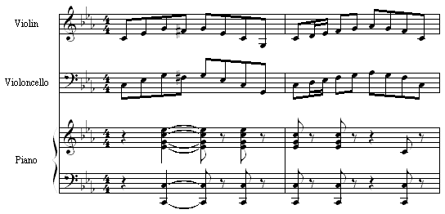
Mendelssohn’s Piano Trio No. 2
Average Note To Note Dynamics Change: 1.46
Chromatic Motion: 0.244
Dominant Spread: 2
Harmonicity of Two Strongest Rhythmic Pulses: 1
Importance of Bass Register: 0.373
Interval Between Strongest Pitch Classes: 7
Most Common Pitch Class Prevalence: 0.39
Note Density: 29.5
Number of Common Melodic Intervals: 6
Number of Strong Pulses: 6
Orchestral Strings Fraction: 0.56
Overall Dynamic Range: 22
Pitch Class Variety: 7
Range: 39
Relative Strength of Most Common Intervals: 0.8
Size of Melodic Arcs: 7.27
Stepwise Motion: 0.439
Strength of Strongest Rhythmic Pulse: 0.173
Variability of Note Duration: 0.104
Variation of Dynamics: 5.98

Slide 8
Feature value comparison
 | Nocturne | Trio
Average Note To Note Dynamic Change | 6.03 | 1.46
Overall Dynamic Range | 62 | 22
Variation of Dynamics | 16.40 | 5.98
Note Density | 3.75 | 29.50
Orchestral Strings Fraction | 0.00 | 0.56
Variability of Note Duration | 0.293 | 0.104
Chromatic Motion | 0.077 | 0.244
Range | 48 | 39

Slide 9
jSymbolic and ELVIS? (1/2)
Searching (short-term)
The set of feature values extracted from a piece serve to characterize and describe it
Users can thus search for all pieces whose features fall within constraints they define
e.g. retrieve all scores where more than x% of motion is parallel, and where less than y% of melodic motion is stepwise
The actual searching and retrieval will be run using Apache Solr infrastructure
Implementation details remain to be finalized

Slide 10
jSymbolic and ELVIS? (2/2)
Classification (long-term)
Features can also serve as percepts for machine learning algorithms
i.e. their “sensory” input
A model can then automatically be “trained” on previously classified pieces (“ground truth instances”), after which it can be used to map previously unseen pieces (based on their feature values) to categories of interest
e.g. train a model to identify probable composers of anonymous scores
I have already written the ACE machine learning software to carry this out this sort of thing
Artificial example with 2 features and 2 composers . . .

Slide 11
Features of training instances

Slide 12
Features of instances to classify

Slide 13
Classifying instances

Slide 14
Classification results

Slide 15
What’s next?
Tristano is currently doing great work upgrading jSymbolic
A priority is to get jSymbolic ready to read MEI neumes
Once MEI is fully neumified in a standard and stable way
What would you like jSymbolic to do?

